Slide 1
ANALOG AND DIGITAL ELECTRONICS
UNIT 3 – COMBINATIONAL LOGIC CIRCUITS
ARITHMETIC LOGIC UNIT
-S.Vaishali

Slide 2
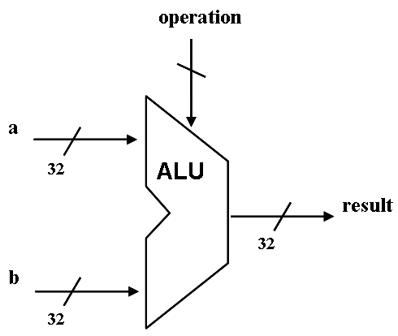
ARITHMETIC LOGIC UNIT
An arithmetic logic unit (ALU)
Performs arithmetic and logic operations
A fundamental building block of the Central Processing Unit (CPU) of a computer
Even the simplest microprocessors contain one for purposes such as maintaining timers
A combinational logic circuit

Slide 3
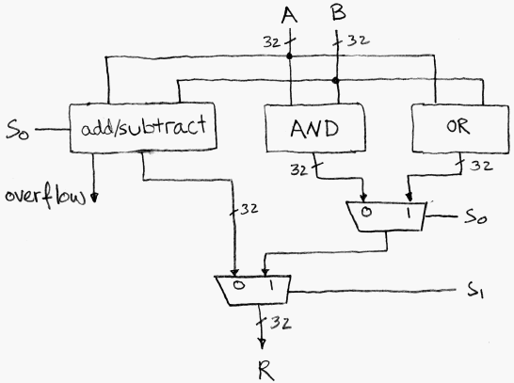
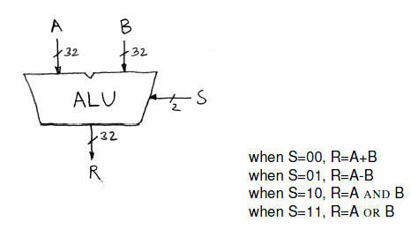
Simple ALU
The S input is controlled by the processor based on the op code

Slide 4
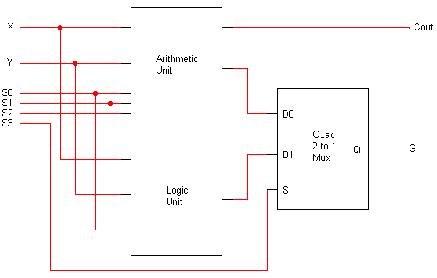
A complete ALU circuit
The / and 4 on a line indicate that it’s actually four lines.
4
4
C_{out} should be ignored when logic operations are performed (when S3=1).
4
4
4
G is the final ALU output.
When S3 = 0, the final output comes from the arithmetic unit.
When S3 = 1, the output comes from the logic unit.
The arithmetic and logic units share the select inputs S1 and S0, but only the arithmetic unit uses S2.

